Slide 1



Advertising Opportunities with the Forums

Slide 2
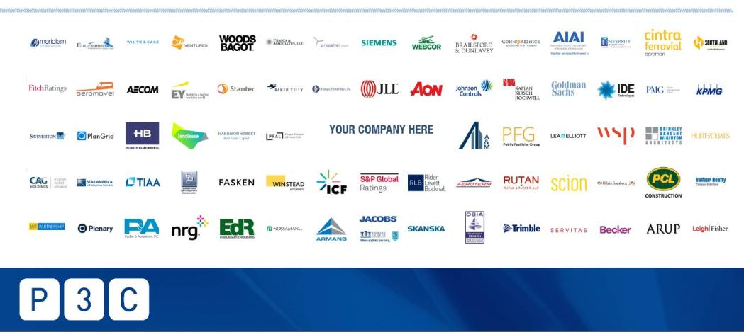
OVERVIEW
Overview
The Goal – Meet your marketing objectives!
The LDC Gas Forums
Our Audience = Your Prospects!
Driving the Forums Audience to your Brand!
Enhance your marketing strategies with the Forums!

Slide 3
The Forums - a Proven Vehicle to Meet Your Marketing Objectives!
THE GOAL
BRAND AWARENESS
ESTABLISH AUTHORITY
QUALIFYING PROSPECTS
LEAD GENERATION
CUSTOMER INTERACTION
Activate high-impact channels with strategic placement of your brand and message to the Forum audience
Continue to engage prospects and customers by pairing your advertising opportunities with face-to-face contact at the Forums
Position your company as the go-to expert in the NatGas market by promoting your expertise and solutions
Turn prospects into leads by promoting your key assets and industry insight
Enrich your sales pipeline by funneling leads directly to your website or sales contact
Complete Audience Activation

Slide 4
THE FORUMS
Where the Natural Gas Industry gathers
for networking, insight and deal-making
6 NATURAL GAS EVENTS
THE FORUMS ARE TRUSTED
ONLINE
Through our 6 regional conferences, our audience learns of our event sponsors/partners and their services via Program Participation, Kiosks, Sponsorship Recognition, and On-site Promotion. We provide vast networking opportunities to give you access to your clients, prospects, and peers.
Through online engagement, the Forums keeps our digital subscriber base of +30,000 natural gas industry professionals informed about our Forums, Sponsors, Partners, and the latest Industry News.
Since 1988, we have been delivering conferences dedicated to bringing the natural gas industry together to network, share insight and do real business.
6 Forums total – each with regional focus:
Southeast, Northeast, Rockies & West, Mid-Continent, Gulf Coast, NatGas To Power

Slide 5






THE FORUMS
10,200⁺
50,000⁺
30,000+
6,000⁺
2,000⁺
Monthly Website Visitors
Total Yearly Websites Views
Known Digital Subscribers
LinkedIn, Facebook & Twitter Followers
Total Annual Conference Attendees
FORUMS AUDIENCE:
Titles of key players who attend the Forums, read our Content and interact with our Sponsors. Many have significant purchase authority/influence.
CEO
President
Vice President
Gas Trader
Manager, Gas Supply & Transportation
Manager, Gas Supply
Managing Director
Business Development
Director, Gas Supply
Marketing Director
Lead Analyst – Energy Buyer
VP, Origination
Senior Process Engineering Manager
Sr. Gas Representative
Head of Energy Supply Services
Vice President, Business Development
Natural Gas Analyst
Scheduler
Manager, Gas Acquisition
Vice President, Administration & Finance
Energy Supply Analyst
VP, Midstream
Customer Success
Sales Manager
Partner
Export Manager
Gas Marketing Representative
Head of North American Natural Gas
Market Originator
Commodity Buyer
Senior Gas Trader
VP Cameron LNG
Mexico Correspondent
Senior Adviser for Mexico & Central America
Reporter
Editor, Mexico Energy Report
Director, Mexico Institute
Vice President, West & Mexico Region
We are committed to helping our event partners/sponsors connect with their target clients.

Slide 6
QUALITY AUDIENCE
Our Audience = Your Prospects!
Forum attendees represent experts and key industry authorities from top Natural Gas Industry players, including:
ACES Power Marketing
Advanced Power
Aethon Energy
Affinius Capital LLC
Aggreko
Albertsons Companies, Inc.
Algas-SDI
Allan Myers, Inc.
Allianz Trade
Alpha Generation
American Electric Power
American Gas Association
American Public Gas Association
AmSty
Antero Resources
Applied Construction Solutions
Approved Energy
Aquatech
Atlas Gas Solutions
Atmos Energy
Atmospheric G2
Avangrid (CNG, SCG, BGC)
Avista
Baltimore Gas & Electric Company
BASF Intertrade Corporation
Basin Electric Power Cooperative
BCP Energy and Industrial
BHE GT&S LLC
Big River Energy, LLC
BKV Corporation
Black Bayou Energy Hub
Black Bear Transmission, LLC
Black Hills Energy
Bloomberg LP
Boardwalk Pipeline Partners
Border States
bp
Bridge Tender Holdings
Bridgeport Utilities
Building Cyber Security
Bunge North America
Bureau of Economic Geology
C&G Electrical LLC
Caldwell Tanks, Inc.
Caliche Development Partners (Golden Triangle Storage)
California Resources Corporation
CAPCO
capSpire, Inc.
Cashman Preload Cryogenics
Castleton Commodities International
CB&I
Cenovus
Center for LNG
CenterPoint Energy Resources
Central Hudson
Certarus (USA) Ltd.
CF Industries
Chart Industries, Inc.
Chevron
CIBC Capital Markets
CIMA ENERGY, LP
Citadel
Citgo Petroleum
Citigroup
Citizens Bank
City of Roseville - Roseville Electric
City of Tallahassee
Clean Energy
Clean Energy Cryogenics
Cleco Power LLC
Cleveland Advisory, LLC
Clone Capital, LLC
CME Group
CNG Delivery LLC
Colonial Energy Inc
Colorado Springs Utilities
Competitive Energy Services
Con Edison
Concord Energy LLC
Conduit Power
ConocoPhillips
Constellation Energy
Context Labs
Cooperative Energy Incorporated
CPS Energy
Decatur Utilities
Delta Utilities
Diversified Energy
Dominion Energy, Inc.
Dragon Power
DRW Energy Trading LLC
DT Midstream
DTE Energy Trading
Duke Energy
DXT Commodities
East Daley Analytics
East Kentucky Power Cooperative
Eastman
Eco Services Operations Corp.
EDF Trading
Edge LNG
EdgeCore Digital Infrastructure
Electric Power Supply Association
Elos Environmental, LLC
Emera Energy
Emerson
Enbridge Gas Inc
Enbridge Inc.
Enchanted Rock
Enerflex
Energir
Energy Transfer
Enestas
ENGIE
Argus Media
Arizona Public Service
Arm Energy
Ascent Resources Utica
Aspen Midstream
Associated Electric Cooperative

Slide 7
Enspire Energy
Enstor Gas
ENSYTE Energy Software Int'l, Inc.
Entergy
Enterprise Products
Enuit LLC
EQT Corporation
Eversource Energy
Evonik Corporation
Expand Energy Corporation
ExxonMobil
Ezpada US LLC
Federal Energy Regulatory Commission
FIS Global
Florida Gas Transmission
Florida Gas Utility
Florida Power & Light Company
Former Governor of Texas and Former US Secretary of Energy
Fort Hill Natural Gas Authority
Freeport LNG Development, L.P.
Frontier Infrasturcture Holdings
Galileo Technologies
Gas Authority
GasSouth
Gaz Metro LNG L.P.
GE Vernova
GenOx Transportation
GIGO Mexico
Glencore
Glendale Energy
Golden Pass LNG
Goldman Sachs
GPA Midstream Association
Granite Shore Power
Great American Gas & Electric
Greenville Utilities Commission
GRUPO CLISA
Guidehouse Inc.
Gulfstream LNG
Hart Energy
Harvard University
Harvest Midstream
HData
HDR Engineering, Inc.
Hilcorp Energy
Honeoye Storage Corp
Hope Gas
Howard Energy Partners
Hull Street Energy
Huntsville Utilities
HV Ventures
HyAxiom / a Doosan Company
Hydria
ICE
Idaho Power Company
IGS Energy
IIR Energy
iLEX Energy Corporation
In Commodities A/S
Industrial Info Resources
INEOS Energy Trading USA
Interconn Resources
International Paper Company
Iroquois Pipeline Operating Company
ISCO Industries
Jane Street
Jera Americas Inc
JPMorgan Chase Bank
Kiewit Energy Group
Killam Oil Co., Ltd.
Kinder Morgan
Knoxville Utilities Board
Koch Energy Services, LLC
Lakeland Electric
Lancaster County Natural Gas Authority
Liberty Energy
Linde, Inc
London Stock Exchange Group
LOOP LLC
LADWP
Lotus Infrastructure Partners
Louisville Gas and Electric Company
LSEG
Maas Energy Works
Macquarie Energy
Mansfield Power and Gas, LLC
Marathon Petroleum Corporation
Massachusetts Municipal (MMWEC)
Mercuria
Merrill Lynch / Bank of America
Methanex
Microsoft
MiQ
Midcontinent Independent System Operator
Mitsui & Co. Energy Marketing Services
Mobile Energy Solutions
Morgan Stanley
Mountaire Farms
MRE Consulting
Municipal Gas Authority of Georgia
Municipal Gas Authority of Mississippi
NatGasHub.com
National Fuel Gas Distribution
National Grid
Natural Gas Intelligence
Natural Gas Supply Association
Naturgy
NeuVentus
New Energy Development Company
New Jersey Natural Gas
New Mexico Gas Company
New York Power Authority
NextDecade
NextEra Energy Marketing
NextEra Energy Resources
NEXUS Gas Transmission
nGenue
NGL Supply Terminals Co
Nikkiso Cosmodyne
NiSource
NJ Resources
NJR Energy Services Company
Nova Scotia Power
NRG Energy, Inc.
Nutrien
NV Energy
NW Natural Gas Co.
OGI Process Equipment
Oglethorpe Power Corporation
Okaloosa Gas District
Oklahoma Natural Gas
Old Dominion Electric Cooperative
ONE Gas, Inc
OneChronos
Oracle
Oregon Institute of Technology
Orlando Utilities Commission
Osaka Gas USA
P66
Pacific Gas & Electric
Pacific Summit Energy LLC
PathPoint Energy, LLC
Patriots Energy Group
PBF Energy
PECO Energy
Pensacola Energy
Peoples Natural Gas
Petrotech, Inc.
Philadelphia Gas Works
Phillips 66
Piedmont Natural Gas
Pivotal LNG
Platts S&P Global
Portland General Electric
Power Infrastructure Partners
PowerGEM
Precision Construction
Procter and Gamble
Prometheus Hyperscale
PSEG Energy Resources & Trade LLC
Public Utility Commission of Texas
PureWest Energy LLC
Quantum Fuel Systems LLC
Quorum Software
Radiate Energy LLC
Railroad Commission of Texas
Rainbow Energy Marketing Corporation

Slide 8
Range Resources
RBN Energy
ReBoSS / EPEC Solutions
Repsol Energy North America
REV LNG, LLC
Rhode Island Energy
Rockpoint Gas Storage
RWE Trading Americas Inc.
S&P Global Commodity Insights / Platts
Sacramento Municipal Utility District
Sage Mesa Marketing & Trading, LLC
Santee Cooper
Sapphire Gas Solutions LLC
Scoville Risk Partners LLC
SDG&E
Seminole Electric Cooperative, Inc
Sempra Infrastructure
Sempra Infrastructure
Seneca Resources Company, LLC
Sequent Energy Management – Williams
SGA Natural Gas Association
Shell Energy North America
Shell Trading Risk Management, LLC
Siemens
Sierra Pacific Power Company
Six Nations Natural Gas
Six One Commodities
Skylar Capital Management
SoCal Gas
Solar Turbines Inc. (Caterpillar)
South Jersey Industries Utilities (SJIU)
Southeast Gas
Southern Company Gas
Southern Natural Gas Pipeline
Southern Power Company
SouthStar Energy Services LLC
Southwest Energy LP
Spark Energy
Spire Marketing Inc.
Spotlight Energy
Sprague Operating Resources
Stabilis Solutions
STACK Infrastructure
Steel Dynamics
Stifel
Summit Utilities Inc.
Swiss Re
Symmetry Energy Solutions, LLC
Synergy Gas Processing
SynMax
Synthica Energy
Tallgrass Energy
Tampa Electric Company
Tampa SEO Agency
Targa Resources
TC Energy Marketing Inc.
TECHGEN
TECO Peoples Gas
Tenaska Marketing Ventures
Tennessee Gas Pipeline
Tennessee Valley Authority
Texas Fueling Services
Texican Natural Gas Company, LLC
Texla Energy Management, Inc.
TG Natural Resources
The Energy Authority
The Energy Cooperative
The Torridon Group and Former US Secretary of Energy
TigerGenCo
TotalEnergies
Trafigura
Transgas Inc.
Trellis Energy Software
TruMarx Data Partners
Tulane University Energy Institute
Twin Eagle Resource Management
Tyson Foods, Inc.
Uniper Global Commodities
United Energy Trading, LLC
Unitil
Utah Gas Corp
Vanguard Renewables
Vantage Data Centers
Vaughn Capital Partners, LLC
Venture Global LNG
Vermont Gas Systems, Inc.
Vicinity Energy (Grays Ferry)
Vitol
VoltaGrid
Washington Gas
Weiss Asset Management
Western Group
Western Midstream Marketing
Westfield Gas & Electric
Westlake Chemical Energy
Williams/Sequent
Woodway Energy Infrastructure
World Kinect Corporation
WTG Energy
WWM Logistics, LLC
Xcel Energy
Yara
York County Natural Gas Authority
Zeus Solutions
Zimtex Fuels, LLC

Slide 9
QUALITY AUDIENCE:
Forum Attendance includes a balanced representation of the industry with a focus on Buyers & Sellers of Natural Gas.
Government/Regulator
Media
Financial & Information Products/Services
Marketing/Trading (Wholesale/Retail)
10%
Producers/E&P
3%
Product/Service Providers
6%
Professional Services
LDCs/Gas Utility
Gas Buyer – End Use/Industrial/ Energy Merchant
20%
Midstream/Pipeline/Storage
Integrated Energy/Majors

Slide 10



























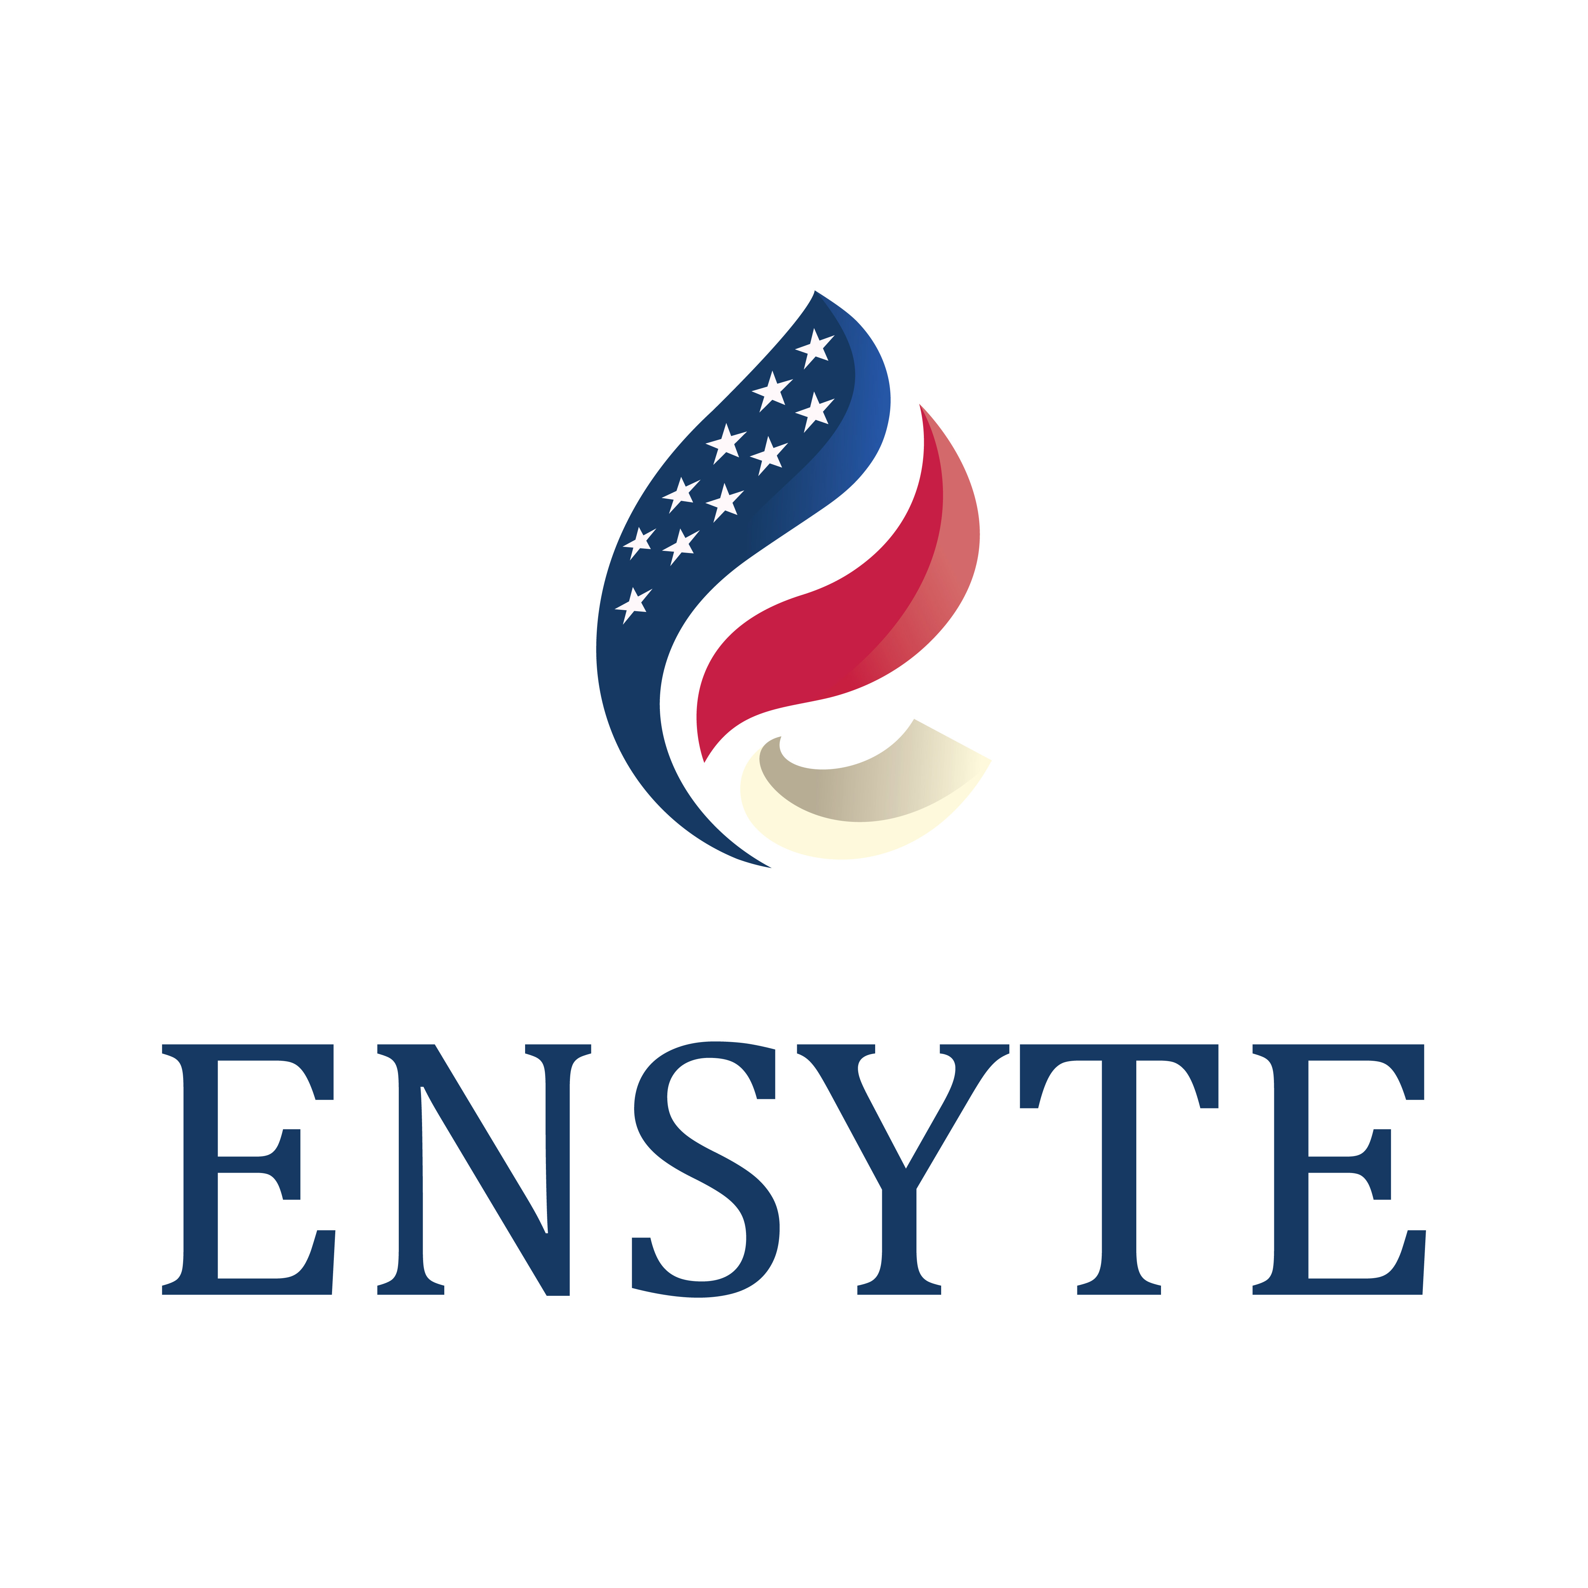









































QUALITY AUDIENCE:
Sponsors represent top players who choose to place their company at the forefront of the Natural Gas industry.

Slide 11





















QUALITY AUDIENCE:
Our Media & Association partners represent and connect with energy companies throughout the industry.

Slide 12
Driving Audience to YOUR BRAND
Driving Audience to YOUR BRAND
Driving Audience to YOUR BRAND
Your Website Ad
When your ad is prominently placed on the Forum website, it will be seen by a steady stream of traffic viewing our events.
Using Targeted Email and Social Media Marketing, we will repeatedly drive our audience to the Forum website to SEE YOUR AD.
Targeted Email Marketing
Multiple weekly communications through targeted email marketing campaigns
Social Media Marketing
Weekly targeted social media postings on our group pages with links to our website
Design your ad containing the text/graphics of your choice to promote your brand
Specific ad sizes are available with strategic placement on our website to maximize exposure to our attendees. For more information on ad sizes and placements, click here.
Add a link to drive prospective customers to your website for more information
Ad performance results tracked through reports/stats
3 general emails per week to over 30,000 recipients each, will drive traffic to our website to see your ad
Additional emails to targeted audiences
Email performance results tracked through reports / stats
Weekly posts to followers on Facebook, LinkedIn, and Twitter
Additional special posts to continually drive additional traffic to our website
Social Media performance results tracked through reports / stats
For ad placement details and pricing,
contact Christy Coleman at ccoleman@accessintel. com

Slide 13
Driving Audience to YOUR BRAND
Driving Audience to YOUR BRAND
CUSTOMIZE your ADVERTISING EXPERIENCE to add even more brand exposure.
Customized, Social Media Posts
Customized Posts with your ad or other text/graphics of your choice to promote your brand
Links in the post drive the audience to your website for more information
Social Media performance results tracked through reports / stats
Additional Opportunities
Ad placements in our Conference Guide
Customized Blog Posts - Guest spots on our LDC Gas Forums website
Post and promote your White Paper containing industry related content and links to your website on our website or via customized email
Promote industry related article/content with links to your website on our website or via customized email
Advertising opportunities onsite at the Forums conferences and a variety of sponsorships opportunities
Face-to-face customer contact – attend the Forums
Other ideas? Let’s talk!!
Customized, Targeted Emails
Customized Emails to our contacts with YOUR ad or other text/graphics of your choice to promote your brand
Links in the body of your custom email drive the audience to your website for more information
Email performance results tracked through reports / stats
Sponsored Webinars
Sponsor webinar on relevant subject matter leveraging the Forum’s 30,000 followers
Exclusive brand presence; establish subject matter expertise
For customized advertising details and pricing, contact Christy Coleman at ccoleman@accessintel. com

Slide 14

Driving Audience to YOUR BRAND
Sponsor a webinar on relevant subject matter leveraging the Forum’s 30,000 followers. Exclusive brand exposure and establish subject matter expertise!
Sponsored Webinars
Promote your thought leadership or case studies with the Forums brand and sponsor a webinar to the Forums audience to collect leads.
You select the topic, date/time, moderator(s) and speakers, and we will take care of the rest! We’ll promote the webinar, include your company name and/or logo in all promotions, and coordinate all logistics and registrations.
For Sponsored Webinars details and pricing, contact Christy Coleman at ccoleman@accessintel.com

Slide 15
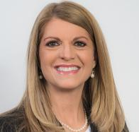
Driving it home!
Enhance your marketing strategies with the Forums!
Leverage the Forums to reinforce your brand and expand your markets.
With a digital audience of 30,000⁺ and thousands of attendees at our live events, the Forums are a community ripe with industry decision makers and key players…just waiting to hear your message!
Let us bring our well-established community to YOU with strategic positioning of your message! Leverage the power of our quality, targeted audience to enhance your marketing strategies.
For more details on building a customized advertising opportunity built with your business in mind, contact:
Christy Coleman
Vice President
LDC Gas Forums
Gulf Coast Energy Forum
NatGas To Power Forum
ccoleman@accessintel.com
Phone: 713-343-1873

