Slide 1



Advertising Opportunities with the Forums - 2020

Slide 2
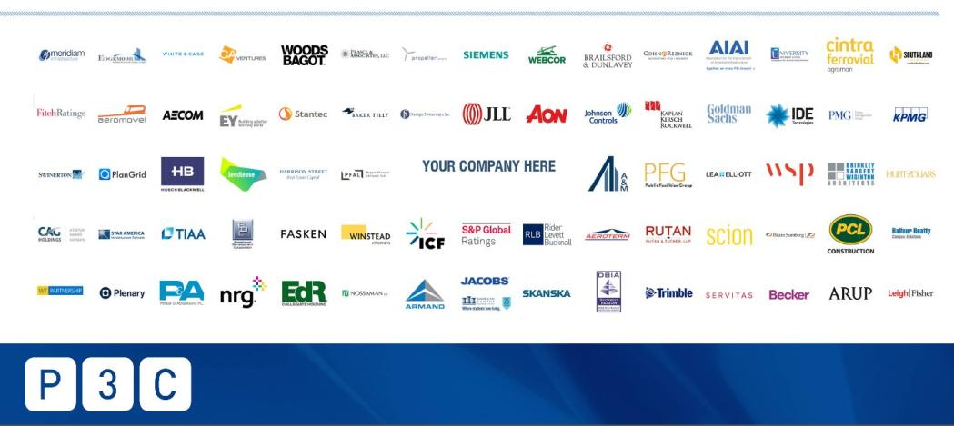
OVERVIEW
Overview
The Goal – Meet your marketing objectives!
The LDC Gas Forums
Our Audience = Your Prospects!
Driving the Forums Audience to your Brand!
Enhance your marketing strategies with the Forums!

Slide 3
The Forums - a Proven Vehicle to Meet Your Marketing Objectives!
THE GOAL
BRAND AWARENESS
ESTABLISH AUTHORITY
QUALIFYING PROSPECTS
LEAD GENERATION
CUSTOMER INTERACTION
Activate high-impact channels with strategic placement of your brand and message to the Forum audience
Continue to engage prospects and customers by pairing your advertising opportunities with face-to-face contact at the Forums
Position your company as the go-to expert in the NatGas market by promoting your expertise and solutions
Turn prospects into leads by promoting your key assets and industry insight
Enrich your sales pipeline by funneling leads directly to your website or sales contact
Complete Audience Activation

Slide 4
THE FORUMS
Where the Natural Gas Industry gathers
for networking, insight and deal-making
6 NATURAL
GAS EVENTS
THE FORUMS
ARE TRUSTED
ONLINE
Through our 6 regional conferences, our audience learns of our event sponsors/partners and their services via Program Participation, Kiosks, Sponsorship Recognition, and On-site Promotion. We provide vast networking opportunities to give you access to your clients, prospects, and peers.
Through online engagement, the Forums keeps our digital subscriber base of +30,000 natural gas industry professionals informed about our Forums, Sponsors, Partners, and the latest Industry News.
Since 1988, we have been delivering conferences dedicated to bringing the natural gas industry together to network, share insight and do real business.
6 Forums total – each with regional focus:
Southeast, Northeast, Rockies & West, Mid-Continent, Gulf Coast, US-Mexico

Slide 5






THE FORUMS
10,200⁺
33,000⁺
30,000+
5,000⁺
2,000⁺
Monthly
Website Visitors
Monthly
Webpage Views
Known Digital Subscribers
LinkedIn, Facebook & Twitter Followers
Total Annual Conference Attendees
FORUMS AUDIENCE:
Titles of key players who attend the Forums, read our Content and interact with our Sponsors. Many have significant purchase authority/influence.
CEO
President
Vice President
Gas Trader
Manager, Gas Supply & Transportation
Manager, Gas Supply
Managing Director
Business Development
Director, Gas Supply
Marketing Director
Lead Analyst – Energy Buyer
VP, Origination
Senior Process Engineering Manager
Sr. Gas Representative
Head of Energy Supply Services
Vice President, Business Development
Natural Gas Analyst
Scheduler
Manager, Gas Acquisition
Vice President, Administration & Finance
Energy Supply Analyst
VP, Midstream
Customer Success
Sales Manager
Partner
Export Manager
Gas Marketing Representative
Head of North American Natural Gas
Market Originator
Commodity Buyer
Senior Gas Trader
VP Cameron LNG
Mexico Correspondent
Senior Adviser for Mexico & Central America
Reporter
Editor, Mexico Energy Report
Director, Mexico Institute
Vice President, West & Mexico Region
We are committed to helping our event partners/sponsors connect with their target clients.

Slide 6
QUALITY AUDIENCE
Our Audience = Your Prospects!
Forum attendees represent experts and key industry authorities from top Natural Gas Industry players, including:
GazMetro Liquefied Natural Gas
Golden Pass LNG
ICE
ICIS
IHS Markit
ION Commodities
Iroquois Gas Transmission System
irthSolutions
Latitude Technologies, An ESG Company
LCM Commodities
LNG Limited
Macquarie
Marlin Gas Services
Millennium Pipeline
Morgan Stanley
National Fuel
NatGasHub.com
Natural Gas Intelligence
NG Advantage
nGenue Retail Energy Systems
Nextera Energy Marketing
NiCHe
Nikkiso Cosmodyne
ODIN
Osaka Gas USA
Alliance Pipeline
American Petroleum Institute
Atlantic Coast Pipeline
Bank of America
BP Energy
Cacheaux Cavazos & Newton
CenterPoint Energy
Chart, Inc.
Chevron
Certarus
Cleveland Advisory
ConocoPhillips
CX Markets
Constellation, An Exelon Company
Direct Energy
Dominion Energy
DTN
EDF Trading
Emera Energy
EMEX
Enable Midstream Partners
Enbridge
ENGIE
Euler Hermes Energy
FIS
Pembina Pipeline
Pivotal LNG
Quantum Fuel Systems
Quorum Software
RBN Energy LLC
Repsol
REVLNG
Rise Solutions
RJO’Brien
S&P Global Platts
Sempra LNG
Sequent Energy Management
Shell Energy
Southern Natural Gas Company, L.L.C.
Spire
Stabilis Energy
Stagecoach Gas Services LLC
Tallgrass Energy
TC Energy
Tellurian
Tenaska
Thigpen Solutions
Trellis Energy Software Solutions
Venture Global LNG
Williams

Slide 7
QUALITY AUDIENCE:
Forum Attendance includes a balanced representation of
the industry with a focus on Buyers & Sellers of Natural Gas.
Government/Regulator
Media
Financial & Information Products/Services
Marketing/Trading (Wholesale/Retail)
10%
Producers/E&P
3%
Product/Service Providers
6%
Professional Services
LDCs/Gas Utility
Gas Buyer –
End Use/Industrial/
Energy Merchant
20%
Midstream/Pipeline/Storage
Integrated Energy/Majors

Slide 8













































QUALITY AUDIENCE:
Sponsors represent top players who choose to place their company at the forefront of the Natural Gas industry.

Slide 9





























QUALITY AUDIENCE:
Our Media & Association partners represent and connect with energy companies throughout the industry.

Slide 10
Driving Audience to YOUR BRAND
Driving Audience
to YOUR BRAND
Driving Audience to YOUR BRAND
Your Website Ad
When your ad is prominently placed on the Forum website, it will be seen by a steady stream of traffic viewing our events.
Using Targeted Email and Social Media Marketing, we will repeatedly drive our audience to the Forum website to SEE YOUR AD.
Targeted Email Marketing
Multiple weekly communications through targeted email marketing campaigns
Social Media Marketing
Weekly targeted social media postings on our group pages with links to our website
Design your ad containing the text/graphics of your choice to promote your brand
Specific ad sizes are available with strategic placement on our website to maximize exposure to our attendees. For more information on ad sizes and placements, click here.
Add a link to drive prospective customers to your website for more information
Ad performance results tracked through reports/stats
3 general emails per week to over 30,000 recipients each, will drive traffic to our website to see your ad
Additional emails to targeted audiences
Email performance results tracked through reports / stats
Weekly posts to followers on Facebook, LinkedIn, and Twitter
Additional special posts to continually drive additional traffic to our website
Social Media performance results tracked through
reports / stats
For ad placement details and pricing,
contact Christy Coleman at christyc@tradefairgroup.com

Slide 11
Driving Audience to YOUR BRAND
Driving Audience to YOUR BRAND
CUSTOMIZE your ADVERTISING EXPERIENCE to add even more brand exposure.
Customized, Social Media Posts
Customized Posts with your ad or other text/graphics of your choice to promote your brand
Links in the post drive the audience to your website for more information
Social Media performance results tracked through reports / stats
Additional Opportunities
Ad placements in our Conference Guide
Customized Blog Posts - Guest spots on our LDC Gas Forums website
Post and promote your White Paper containing industry related content and links to your website on our website or via customized email
Promote industry related article/content with links to your website on our website or via customized email
Advertising opportunities onsite at the Forums conferences and a variety of sponsorships opportunities
Face-to-face customer contact – attend the Forums
Other ideas? Let’s talk!!
Customized, Targeted Emails
Customized Emails to our contacts with YOUR ad or other text/graphics of your choice to promote your brand
Links in the body of your custom email drive the audience to your website for more information
Email performance results tracked through reports / stats
Sponsored Webinars
Sponsor webinar on relevant subject matter leveraging the Forum’s 30,000 followers
Exclusive brand presence; establish subject matter expertise
For customized advertising details and pricing, contact Christy Coleman at christyc@tradefairgroup.com

Slide 12

Driving Audience to YOUR BRAND
Sponsor a webinar on relevant subject matter leveraging the Forum’s 30,000 followers. Exclusive brand exposure and establish subject matter expertise!
Sponsored Webinars
Promote your thought leadership or case studies with the Forums brand and sponsor a webinar to the Forums audience to collect leads.
You select the topic, date/time, moderator(s) and speakers, and we will take care of the rest! We’ll promote the webinar, include your company name and/or logo in all promotions, and coordinate all logistics and registrations.
For Sponsored Webinars details and pricing, contact Christy Coleman at christyc@tradefairgroup.com

Slide 13
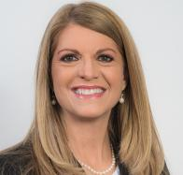
Driving it home!
Enhance your marketing strategies with the Forums!
Leverage the Forums to reinforce your brand and expand your markets.
With a digital audience of 30,000⁺ and thousands of attendees at our live events, the Forums are a community ripe with industry decision makers and key players…just waiting to hear your message!
Let us bring our well-established community to YOU with strategic positioning of your message! Leverage the power of our quality, targeted audience to enhance your marketing strategies.
For more details on building a customized advertising opportunity built with your business in mind, contact:
Christy Coleman
Vice President
LDC Gas Forums
Gulf Coast Energy Forum
US-Mexico Natural Gas Forum
christyc@tradefairgroup.com
Phone: 713-343-1873

